Slide 1
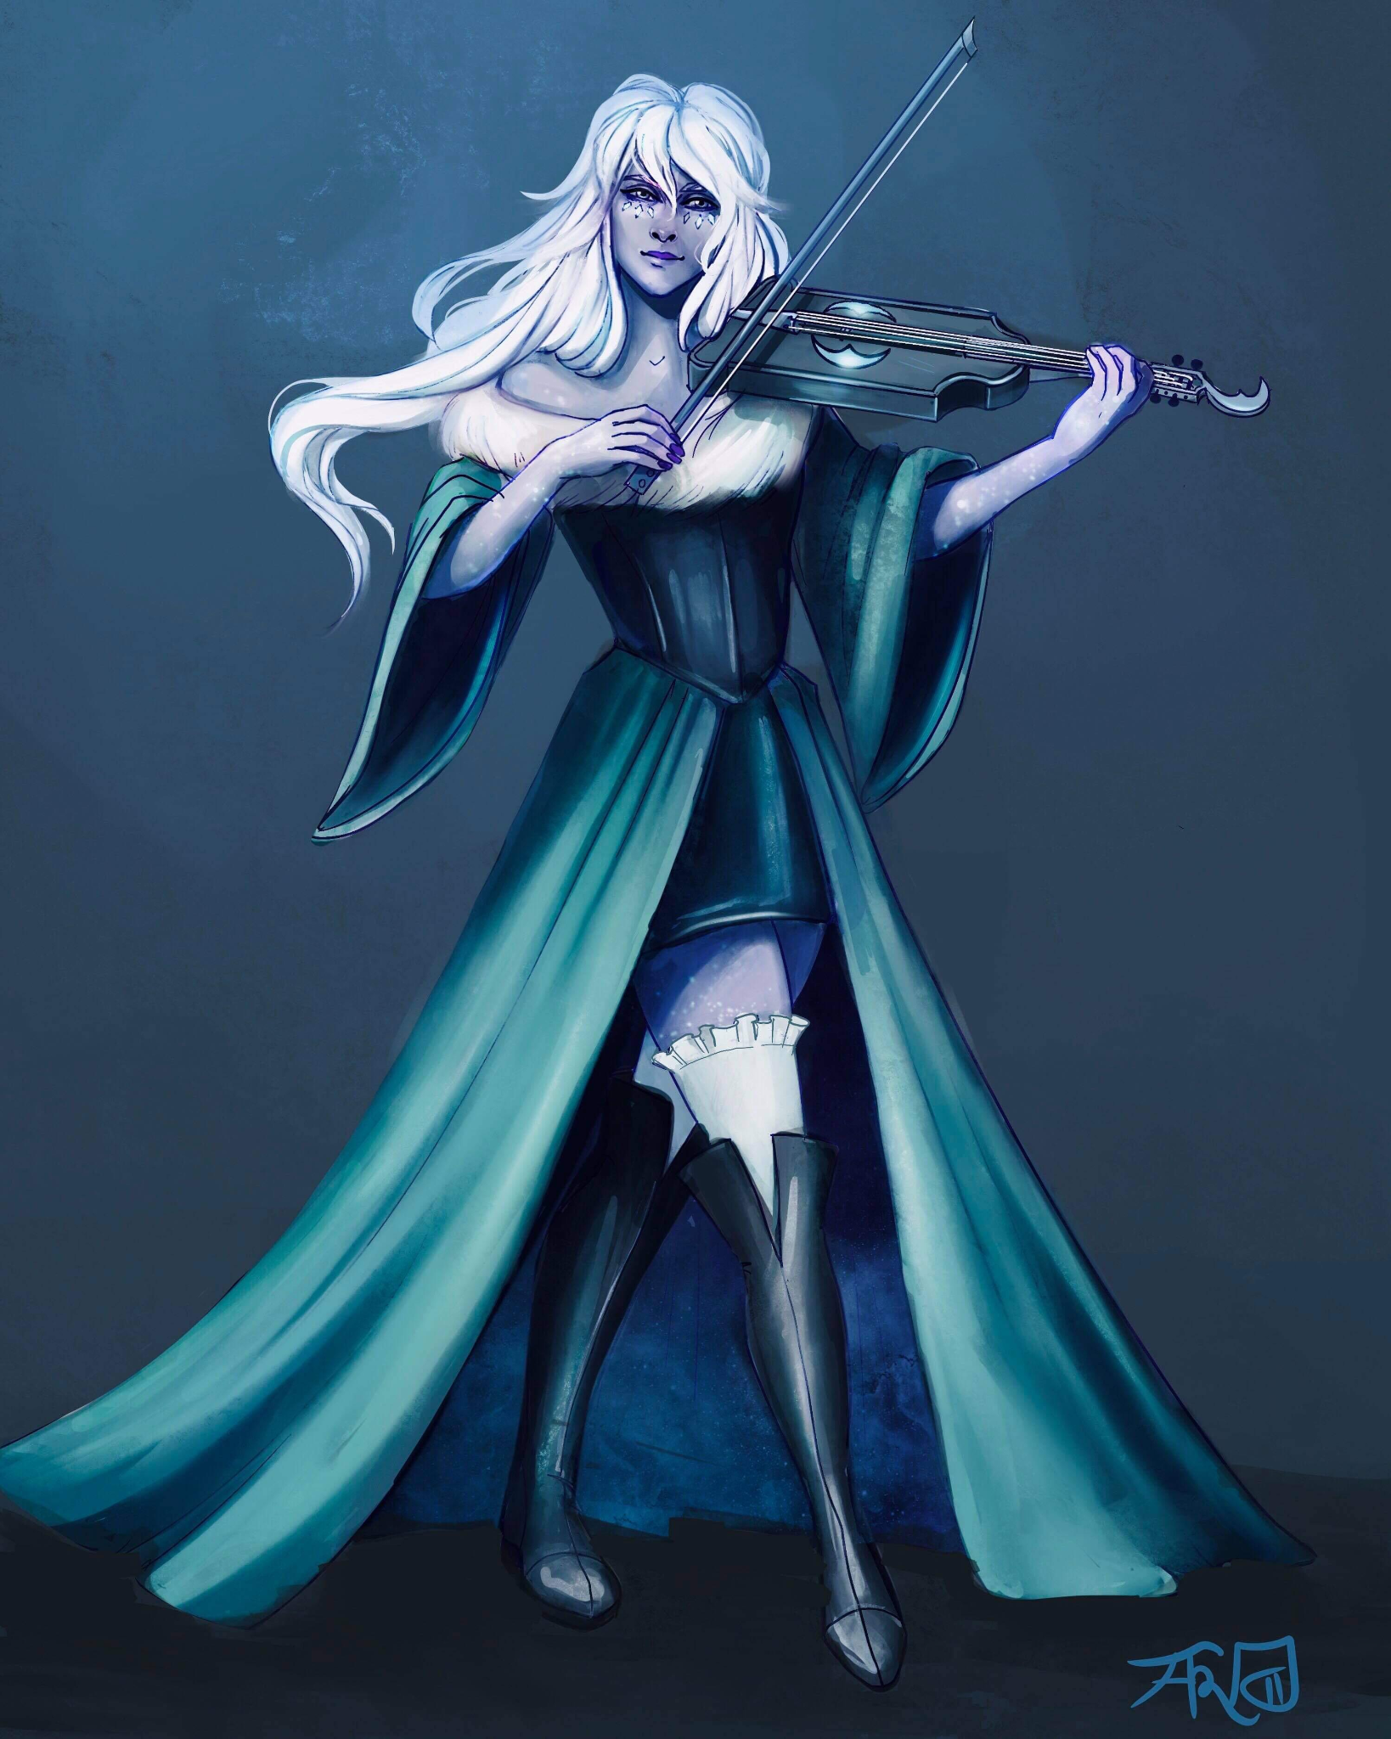
Bethany [Last Name UNKNOWN]
Assistant at the Day Dream Library
Loves to play Viola and wants to prove her worth by joining the Flatcoat Circus.

Slide 2
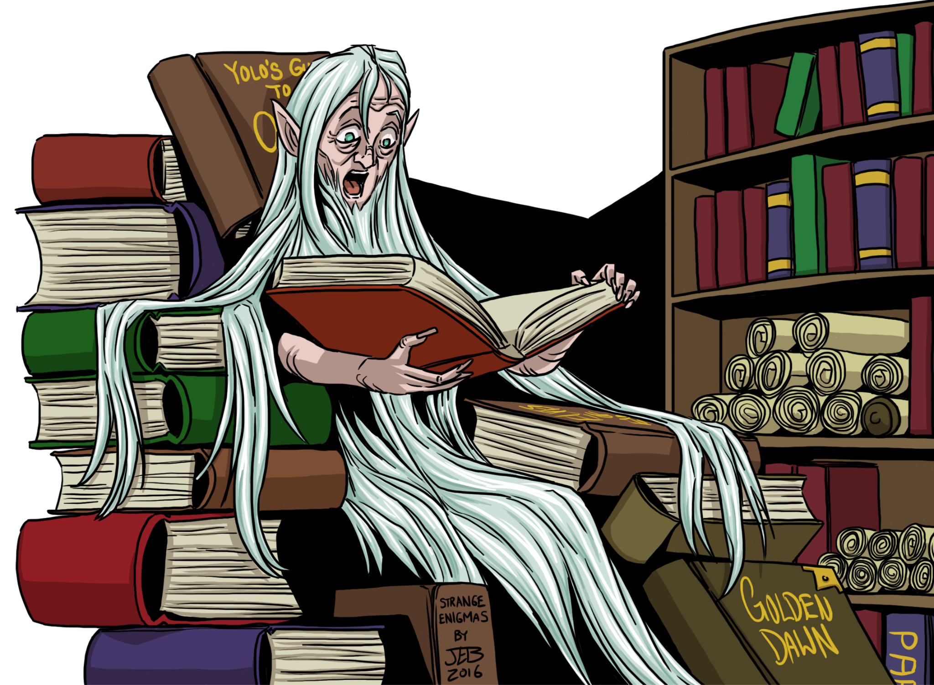
[First and Last Name UNKNOWN]
Owner of the Day Dream Library

Slide 3
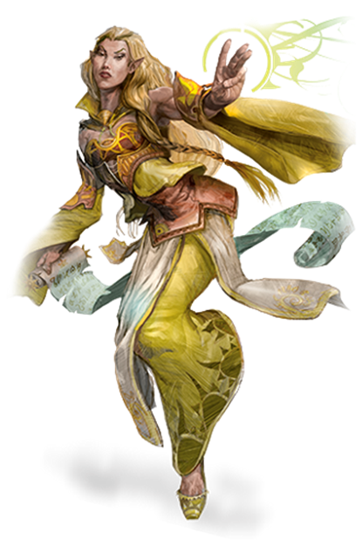
Ramora [Last Name UNKNOWN]
Traveling Adventurer
Works Part-Time at the Day Dream Library
Extremely interested in any ancient artifact

Slide 4
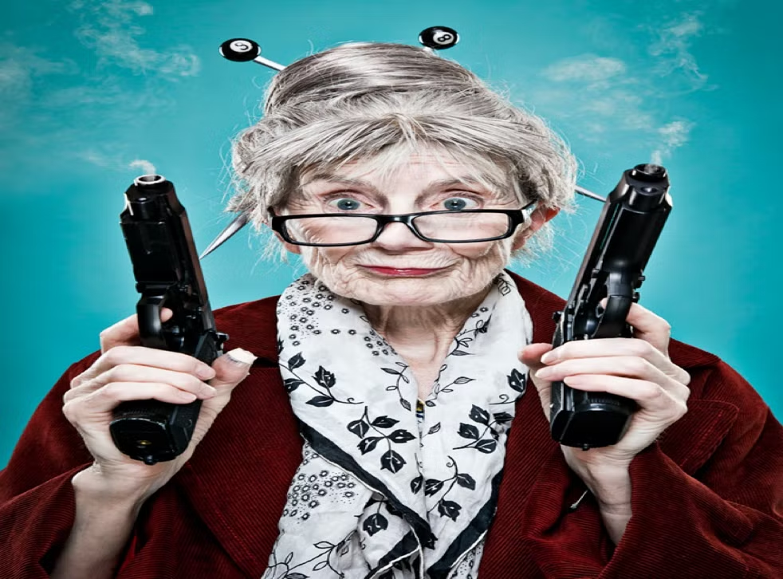
Swan [Last Name UNKNOWN]
Owner of The Thoughtful Baker Bar
Extremely quick when getting drinks and food.

Slide 5
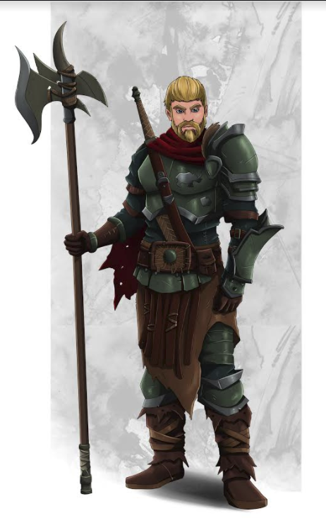
Rhino [Last Name UNKNOWN]
Ex-Arm Wrestling Champion of Helmfield

Slide 6
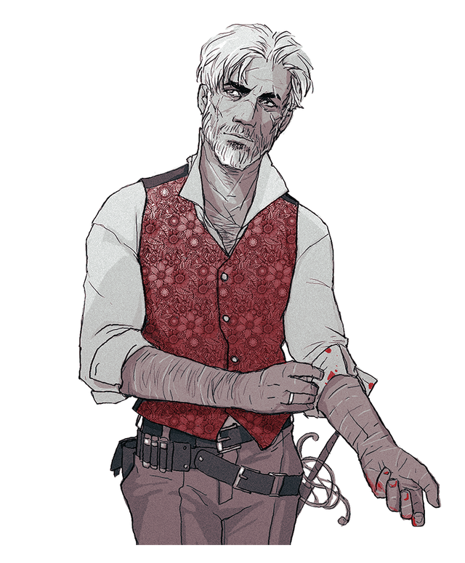
Penguin [Last Name UNKNOWN]
Close to Rhino

Slide 7
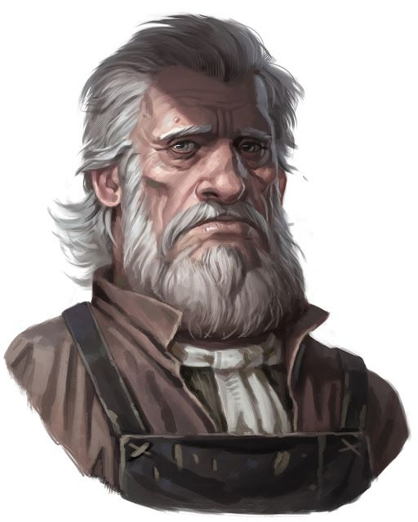
[First and Last Name UNKNOWN]
Owner of the White Basin Hotel

Slide 8
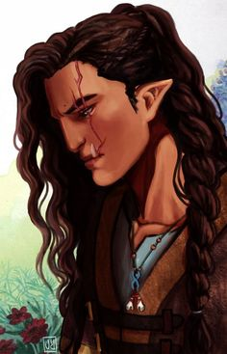
Beverly Caskbow
Owner of the Flowing Hammer
Got her scar from the Helmfield Cave
Joined you in the Helmfield Cave.
Level 3 - Barbarian
STR | DEX | CON | INT | WIS | CHA
19 (+4) | 8 (-1) | 19 (+4) | 7 (-2) | 7 (-2) | 10 (+0)

Slide 9
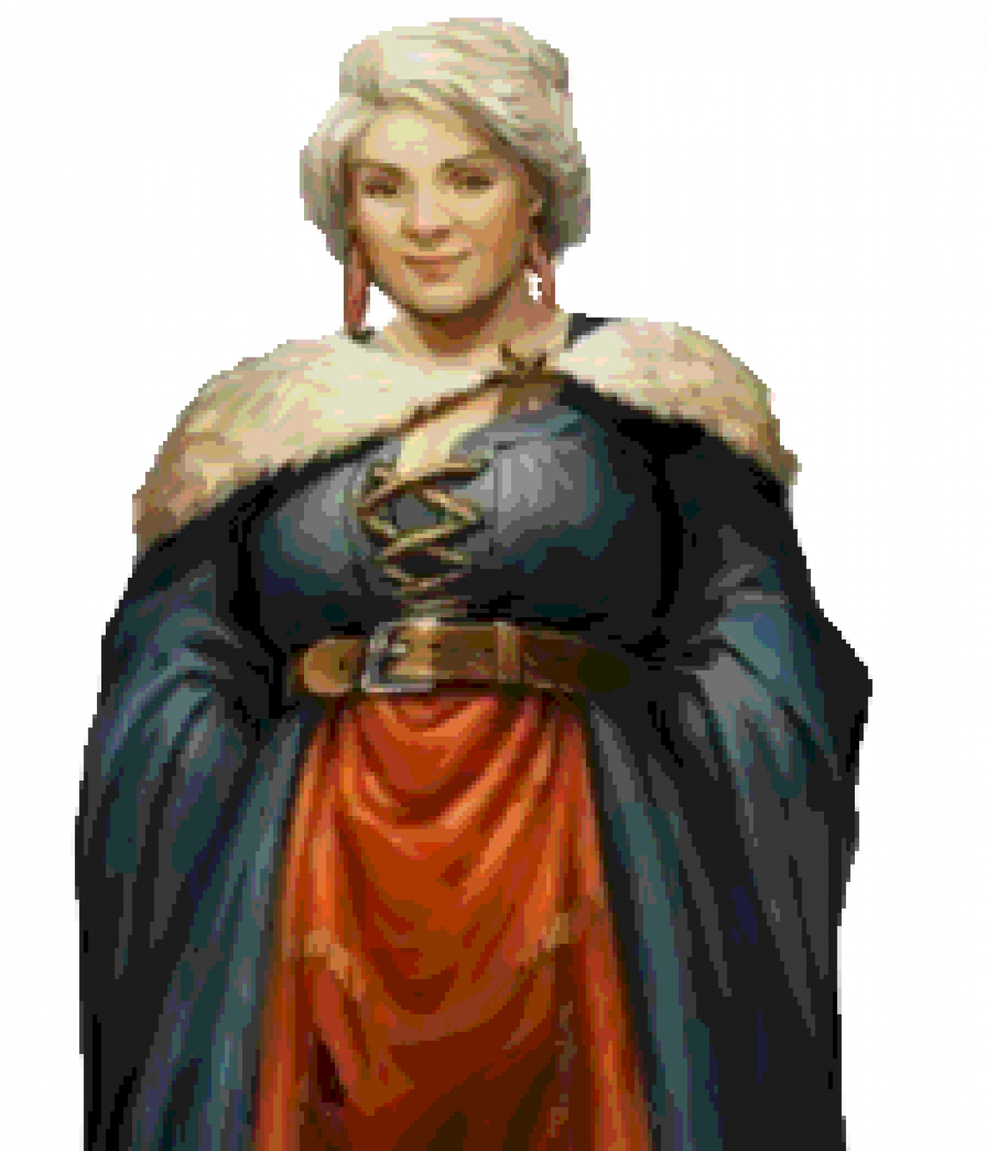
Godiva Commonbrook
Mayor of Helmfield
Her motto: “The people are first, the government is corrupt and make everyone happy!”

